Slide 1
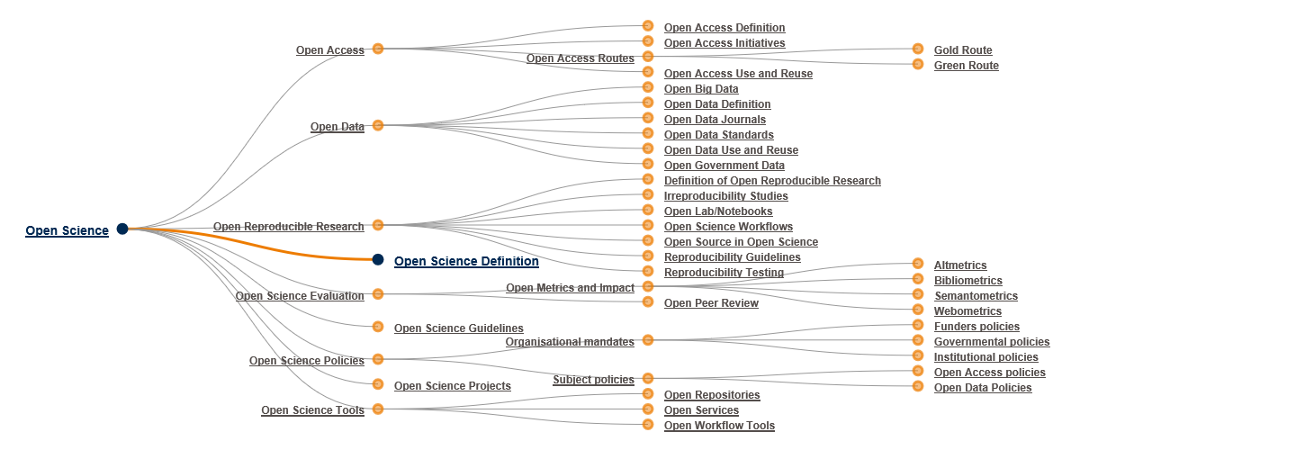
CALLENGES to EC, National and regional policies related to open science, OPEN INNOVATION, OPEN TO THE WORLD
Kostadin Kostadinov
GIS-TransferCenter Foundation

Slide 2
Open science is the movement to make scientific research, data and dissemination accessible to all levels of an inquiring society.

Slide 3
Introduction
Building a knowledge society requires universal access to information and knowledge through information and communication technologies (ICT).
A key role for this is free access to scientific information and recently obtained research results.
OPEN SCIENCE:
Open to the scientists
Open to the schools
Open to the society/industry
Open to the policy - evidence based policy decisions
inquiring society

Slide 4
Bulgarian situation
The National Strategy for the Development of Scientific Research in the Republic of Bulgaria 2017 - 2030 adopted in June 2017 by the National Assembly envisages open access publications as a main element of the Strategic aim of increasing the research results visibility.
Key indicator – number of scientific publications with open access is included as an informative indicator in the Regulations for monitoring and assessment of scientific activities performed by PF RO&U.A

Slide 5
OPEN INNOVATION
Focusing on the type definition as "a distributed innovation process based on purposively managed knowledge flows across organizational boundaries, using pecuniary and non-pecuniary mechanisms in line with the organization's business model we can define the following challenges:
1. Knowledge and technology transfer – one of the BG presidency’s priority is becoming more and more important for innovation;
We have to find new and smart approaches for realization of knowledge and technology transfer – e.g. AI-based K&TT

Slide 6
IP Challenges with Transfer of Knowledge
Complementarity Between Open Science and IPRs
The general aim of the EU Open Science policy is to enable the replicability and/or the uptake of research results by others. The end goal of such policy should be to enable these research results to be used in an Open Innovation context, thereby speeding up the uptake of innovation with high impact for society.
However, there are several ways to reach this objective, including by means of IPRs.
An unbalanced one-size-fits-all European Open Science policy where the concept of Open Science is still too often associated with “free of charge access for all” would be highly detrimental to European RD&I ecosystems. This would prevent industry from securing the element of shared “value capture” essential to Open Innovation.

Slide 7
General IP Misconceptions in academia/ industry
Complementarity Between Open Science and IPRs
Promoting a balanced approach between Open Science and IPR is therefore essential to provide the right framework for research organisations like RTOs to fulfil their strategic role: solving both societal and industrial challenges.
The IPR framework is an essential tool to facilitate, regulate and secure Open Science, by ensuring that the efforts from different contributors are correctly rewarded. IPR are key to offer balanced rights to both the users and creators of Open Science content.

Slide 8
Different types of Innovation:
Open Innovation: At the Core of RTOs’ Business Model
Open innovation is characterized by:
“value creation” by the partners working in collaboration, co-creating knowledge to boost innovation output, and
• “value capture” under conditions that enable each partner of the collaboration to capture a share of the economic value created in common.
Open innovation is embedded in European RTOs’ business models. They are developing and co-creating knowledge and technology with a wide range of RD&I actors across the whole value-chain, from low to high TRL. RTOs develop new breakthrough technologies, with a market-oriented approach and the objective to develop strong Intellectual Property. This enables them to ensure that the technology they develop reaches the market with high impact. They have different ways to do so:
Directly commissioned collaborative projects with private partner(s):
IP licencing among various participating partners is an important model of “open innovation” collaboration.
Start-ups

Slide 9
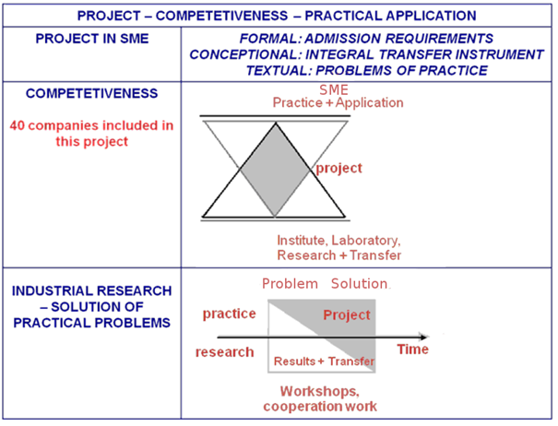
The Innovation Cycle - RTOs-Industry Collaboration
Preliminary TT
KT
TT
Value creation to Socio-Economic Impact through K&TT
Source: Fraunhofer (modified by EARTO and K. Kostadinov)

Slide 10
OPEN INNOVATION
Focusing on the type definition as "a distributed innovation process based on purposively managed knowledge flows across organizational boundaries, using pecuniary and non-pecuniary mechanisms in line with the organization's business model we can define the following challenges:
2. Better exploiting of the existing approaches such as JTI, JU, national or international research missions & research programs that respond to the needs and challenges of society.
ICT for science, education and security;
Hydrogen fuel cells and electrical mobility;
Personalized medicine etc.

Slide 11
Национални научни програми
Име на програмата | Бюджет целия период | 2018 | 2019 | 2020 | 2022 | Организации изпълнители | М-во поръчител
Информационни и комуникационни технологии за единен цифров пазар в науката, образованието и сигурността (ИКТ в НОС) | 3 000 000 лв. | 1 200 000 лв. | 900 000 лв. | 900 000 лв. |  | БАН, ТУ-София, СУ-София | МТИТС
Електронно здравеопазване в България (е-Здраве) | 2 000 000 лв. | 800 000 лв. | 600 000 лв. | 600 000 лв. |  | БАН, МУ-София, СУ-София, Му-Пловдив | МЗ
Репродуктивните биотехнологии в животновъдството в България (РЕПРОБИОТЕХ) | 1 500 000 лв. | 800 000 лв. | 800 000 лв. |  |  | Тракийски у-т, БАН, СУ-София, Аграрен у-т | МЗХГ
Нисковъглеродна енергия за транспорта и бита (ЕПЛЮС) | 7 300 000 лв. | 2 920 000 лв. | 2 190 000 лв. | 2 190 000 лв. |  | БАН, ТУ-София, СУ-София, ТУ-Варна, ХТМУ, БУ"А. Златаров", ПУ, РУ, ЮЗУ | МЕ
Опазване на околната среда и намаляване на риска от неблагоприятни явления и природни бедствия | 6 000 000 лв. | 1 200 000 лв. | 1 200 000 лв. | 1 200 000 лв. |  | БАН, СУ, Лесотехн у-т, БУ"А. Златаров" | МОСВ
Културноисторическо наследство, национална памет и прогрес на обществото (КИННППО) | 4 000 000 лв. | 1 600 000 лв. | 1 200 000 лв. | 1 200 000 лв. |  | СУ, БАН, ЮЗУ | МК
Здравословни храни за силна биоикономика и качество на живот | 6 000 000 лв. | 1 500 000 лв. | 1 500 000 лв. | 1 500 000 лв. | 1 500 000 лв. | Аграрен, БАН, ССА, Тракийски у-т | МЗХГ
Всичко | 29 800 000 лв. | 10 020 000 лв. | 8 390 000 лв. | 7 590 000 лв. | 1 500 000 лв.

Slide 12


GIS-TransferCenter
STEINBEIS’s Project competitiveness concept

Slide 13
OPEN INNOVATION
Focusing on the type definition as "a distributed innovation process based on purposively managed knowledge flows across organizational boundaries, using pecuniary and non-pecuniary mechanisms in line with the organization's business model we can define the following challenges:
3. Intellectual property policy - the key to success in commercializing research results.
IP is an asset with commercial value, which is easily realized on the market via licensing or creating high-tech start-ups, their scale up, etc.

Slide 14
OPEN INNOVATION
4. Strengthening city partnerships with EU, international and local stakeholders on establishment of research & innovation hub for capacity building, training and research evidence-based measures, for more efficient, effective and future oriented urban and regional policies.
The Science, Technology and Innovation Expert Council of the Mayor of Sofia - Ms. J. Fandakova assists the Mayor from June 2012 and has been reported in the Competitiveness Council as a good practice for the formation of science-based and effective urban policies.
The European Initiative "Science meets Parliament" and "Science meets Regions" promotes the policy to benefit from open science and open innovation.

Slide 15
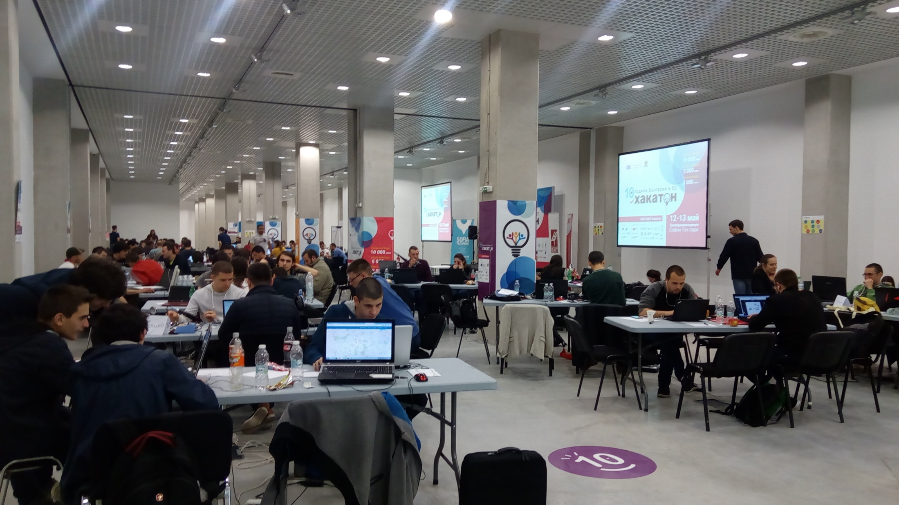
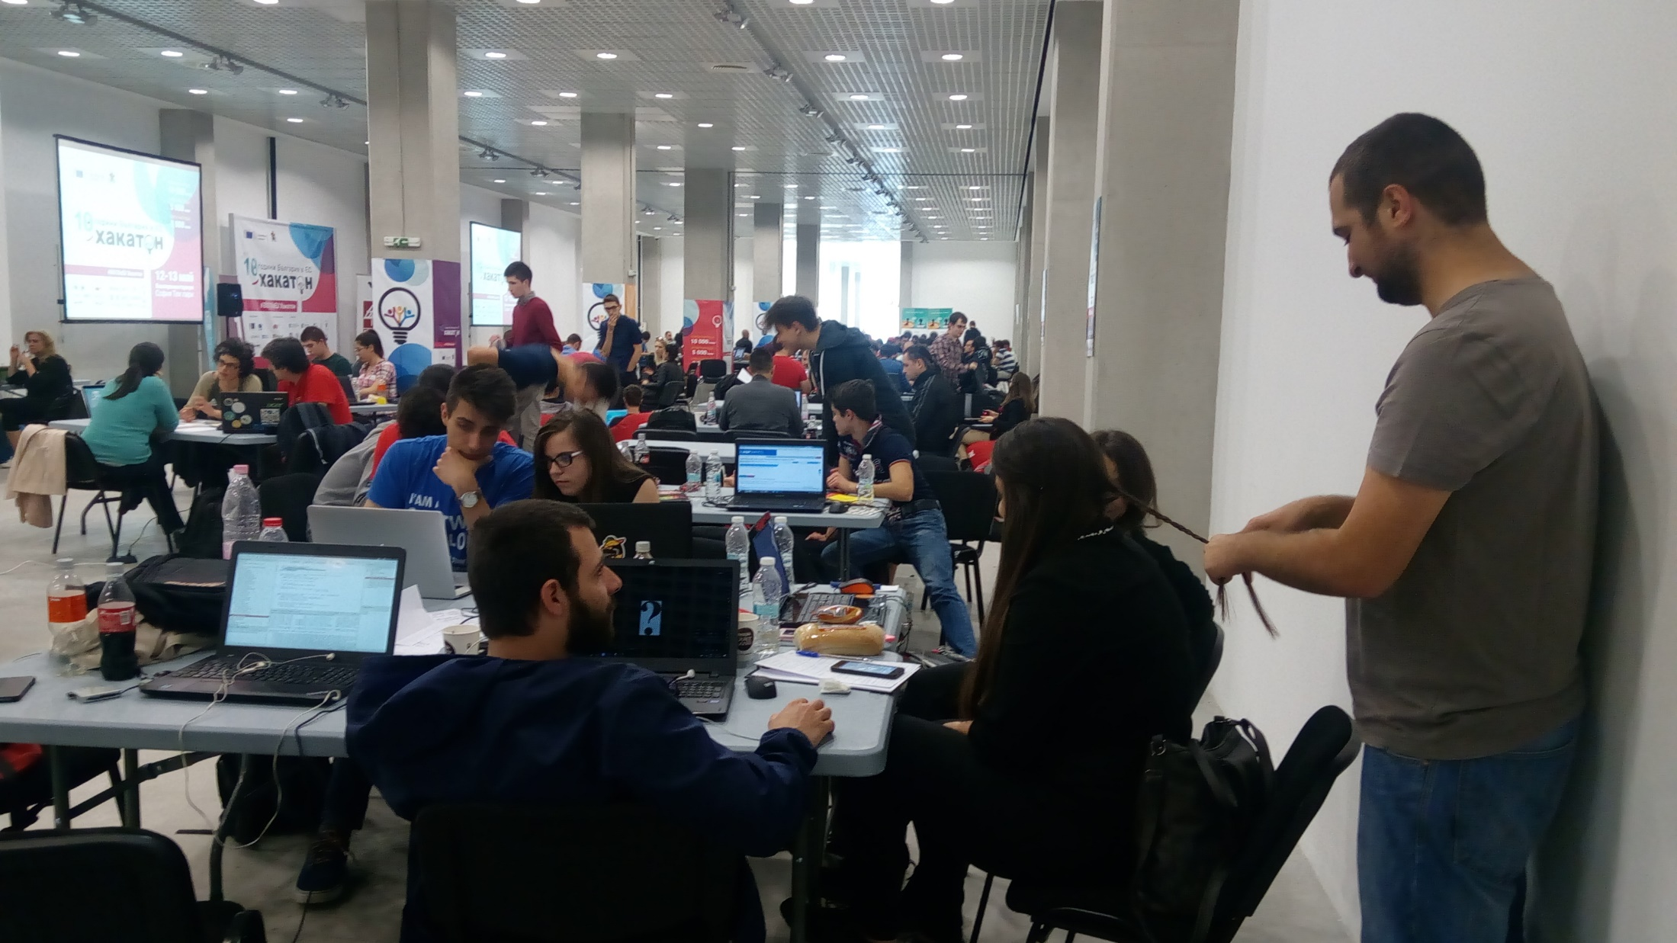
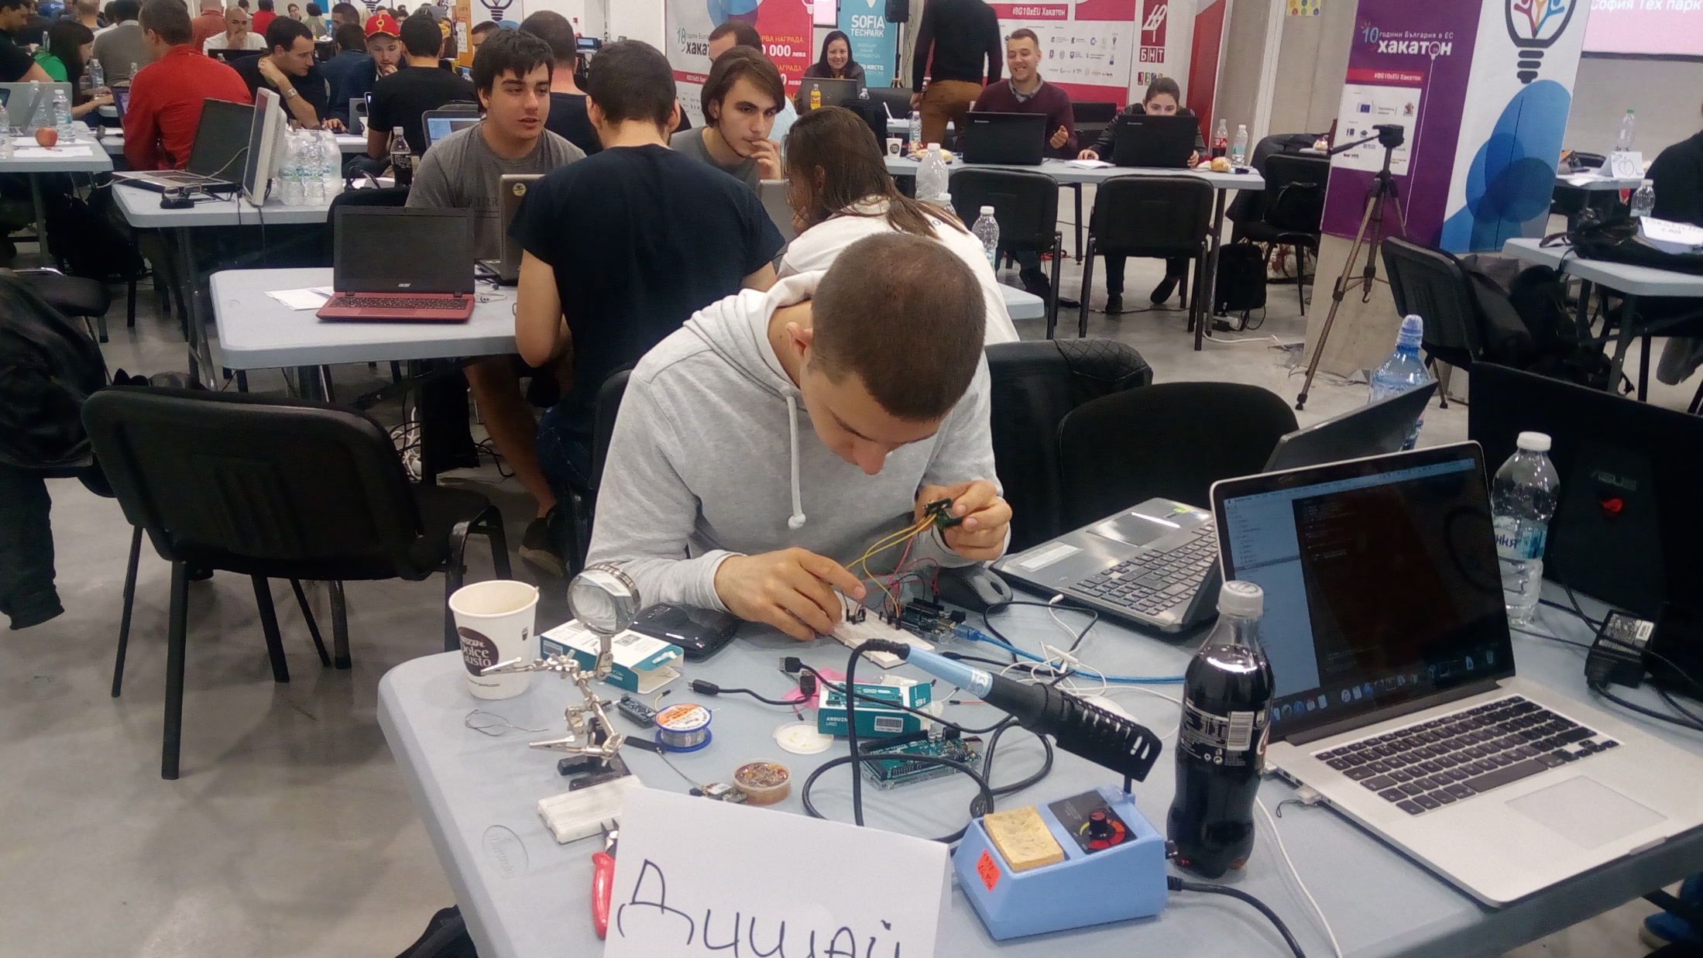
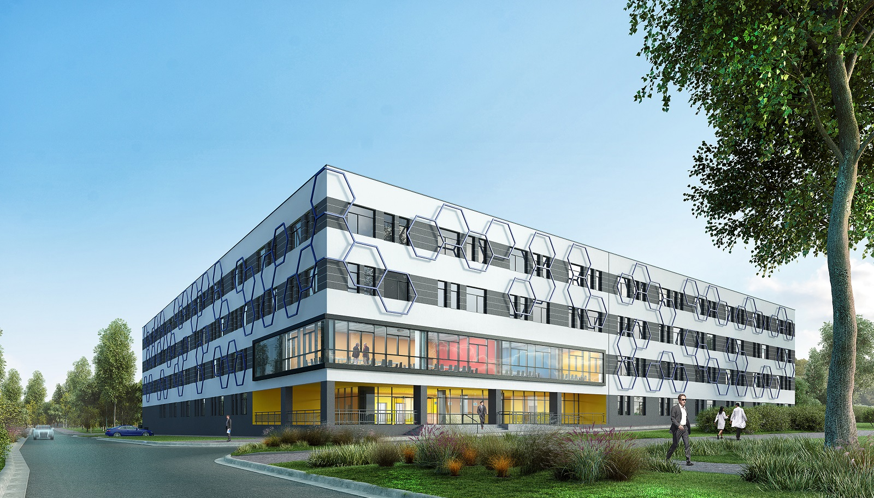
OPEN INNOVATION
Sofia Municipality through its Agency for Development of Sofia organizes open innovation hackathons for societal, ecological and etc. urban development in line of the Sofia’s RIS3

Slide 16
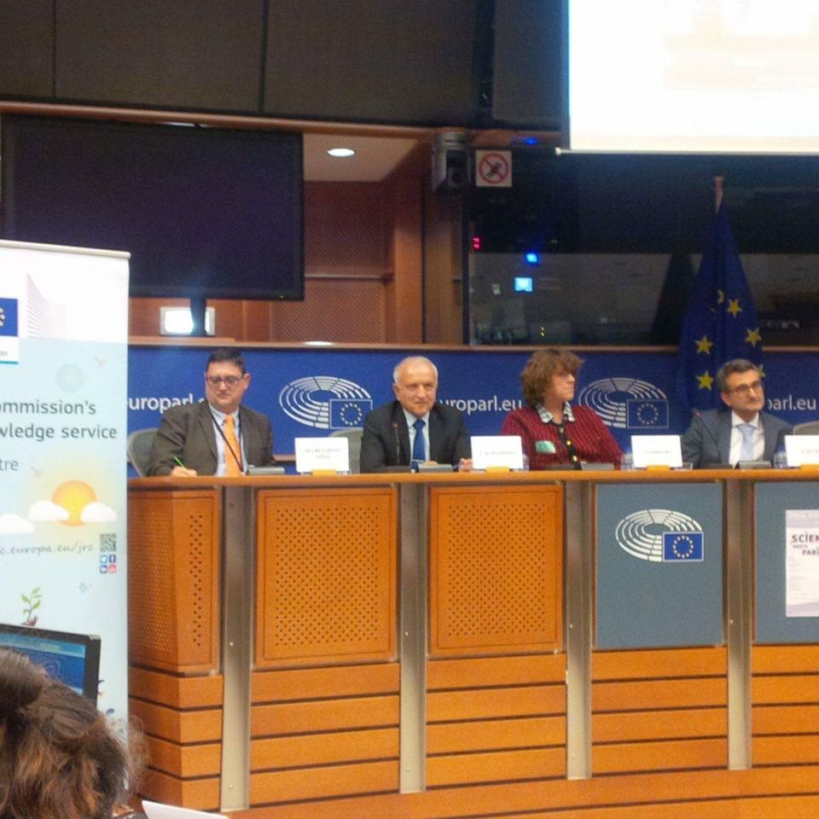
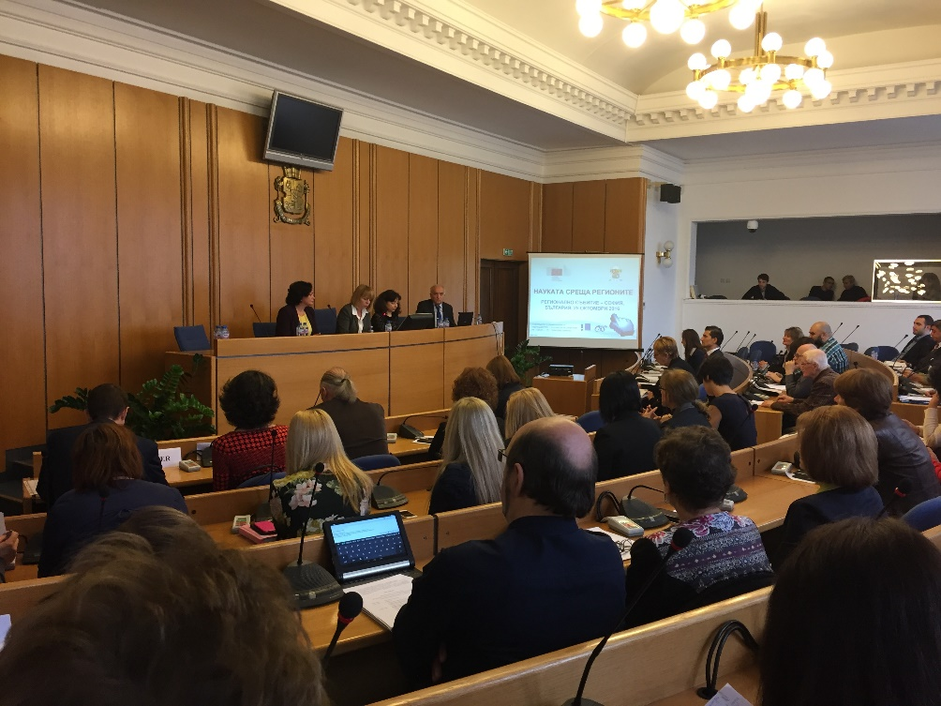
6. How to use science to form science-based and effective policies?
Science meets Regions Science meets Parliament

Slide 17
6. How to use science to form science-based and effective policies?
Science meets Parliament
European Parliament
STOA- Science and Technology Options Assessment
Mission: providing Parliament’s Committees and other parliamentary bodies concerned with independent, high-quality and scientifically impartial studies and information for the assessment of the impact of possibly introducing or promoting new technologies and identifying, from the technological point of view, the options for the best courses of action to take;
The STOA Panel forms an integral part of the structure of the European Parliament. It is composed of 25 Members of the European Parliament (MEPs) who are nominated by nine permanent Committees of the Parliament: AGRI, CULT, EMPL, ENVI, IMCO, ITRE, JURI, LIBE and TRAN.
All Panel Member have scientific advisor who is working in MEP-Scientist Pairing Scheme
Thematic priority areas
Eco-efficient transport and modern energy solutions;
Sustainable management of natural resources;
Potential and challenges of the Internet;
Health and new technologies in the life sciences;
Science policy, communication and global networking.

Slide 18
CONCLUSION
Efforts need to be made to improve the transformation of knowledge available through open science into socio-economic advantages through open innovation (AI-based K&TT, improving science-education-business partnership, Strengthening city partnerships, etc.).
OPEN SCIENCE → OPEN INNOVATION → OPEN TO THE WORLD =>
HIGHER GLOBAL COMPTETETIVNESS INDEX
The challenge that science puts to the policy, is to find effective instruments that make science a major factor for Europe's economic development and a place with high quality of life for its citizens, such as:
Open Science – how to encourage the society to look for/use RR
Monitoring and assessment of research activities of PF R&U O;
Funding the research depending on the results obtained;
RRI Funding – research&innovation meeting the societal and industrial needs;
...???

